Slide 1
Lesson 8: Hosting services
KS4 – Computer networks
Notes:
Last updated 30-06-2021
Resources are updated regularly — the latest version is available at: ncce.io/tcc.
This resource is licensed under the Open Government Licence, version 3. For more information on this licence, see ncce.io/ogl.

Slide 2

What happens in an internet minute?
Starter activity
Approximate how many times the following things happen through the internet in a single minute:
How many instant messages?
How many hours of YouTube content are uploaded?
How many tweets are sent?
Notes:
Image source: https://pixabay.com/photos/time-clock-watch-hours-minutes-371226/

Slide 3
What happens in an internet minute?
Starter activity
Instant messages
Notes:
Internet minute information source: https://ediscoverytoday.com/2021/04/16/here-is-your-2021-internet-minute-infographic-ediscovery-trends/

Slide 4
What happens in an internet minute?
Starter activity
Instant messages
69 million!

Slide 5
What happens in an internet minute?
Starter activity
Content uploaded to YouTube

Slide 6
What happens in an internet minute?
Starter activity
Content uploaded to YouTube
500 hours!

Slide 7
What happens in an internet minute?
Starter activity
Tweets sent

Slide 8
What happens in an internet minute?
Starter activity
Tweets sent
200,000!

Slide 9

Lesson 8: Hosting services
Objectives
In this lesson, you will:
Describe how servers are used for hosting services across the internet
Describe the role of web servers and clients
Describe how the cloud provides services for software and storage
List the advantages and disadvantages of the cloud

Slide 10
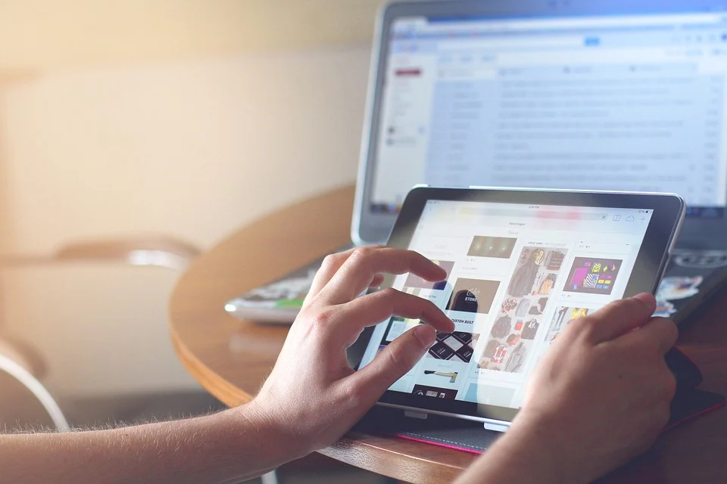
The internet
Activity 1
The internet is used for much more than simply browsing web pages on the world wide web, we can:
Purchase online goods
Stream movies
Take video calls
Play online games
Post on social media
And much more!
Notes:
Image source: https://pixabay.com/photos/hands-ipad-tablet-technology-820272/

Slide 11
Web hosting
Activity 1
For all of this to be possible, any content or services must be hosted somewhere.
Web servers are used to host (house) content and services that can be accessed through the internet.
Notes:
Image source: https://pixabay.com/photos/hands-ipad-tablet-technology-820272/

Slide 12
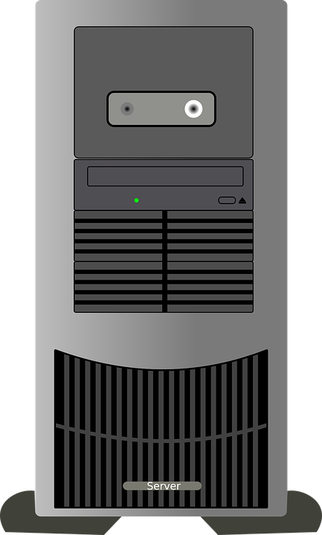

Web hosting
Activity 1
Think back to the client–server model.
The client is the device used to access the content or services.
The host is the server(s) where the content and services are served to the client.
Client
Server

Slide 13
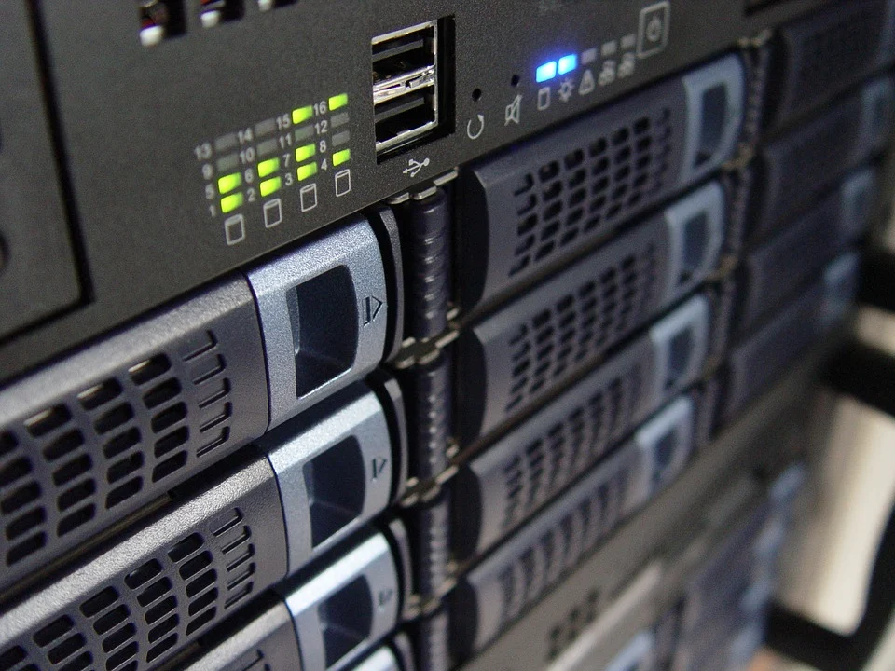
External web hosting provider
Activity 1
Most websites are hosted using an external web hosting provider.
These hosting companies have their own dedicated servers that they ‘rent out’ to businesses and individuals as a space to host their websites.
Notes:
Image source: https://pixabay.com/photos/technology-servers-server-1587673/

Slide 14
External web hosting provider
Activity 1
These companies often provide other services like:
Security
Website builders
Backup guarantees
Technical support
Email services
Analytics
Notes:
Image source: https://pixabay.com/photos/technology-servers-server-1587673/

Slide 15
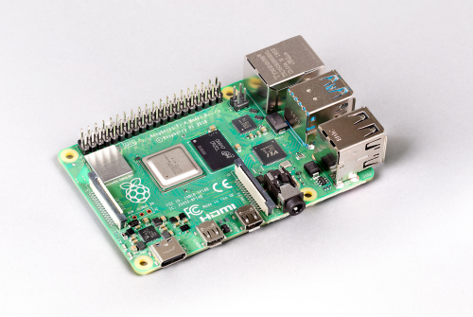
Personal web hosting
Activity 1
Individuals can also set up their own web servers and make these available to access through the internet.
This can be done using an old PC or even a Raspberry Pi!
Notes:
Image source: Raspberry Pi

Slide 16
Personal web hosting
Activity 1
If you host your own web server then you are responsible for:
Security (very important because personal web servers are prone to hacking)
Backups
Technical support
Maintenance
Keeping it switched on at all times
Notes:
Image source: Raspberry Pi

Slide 17
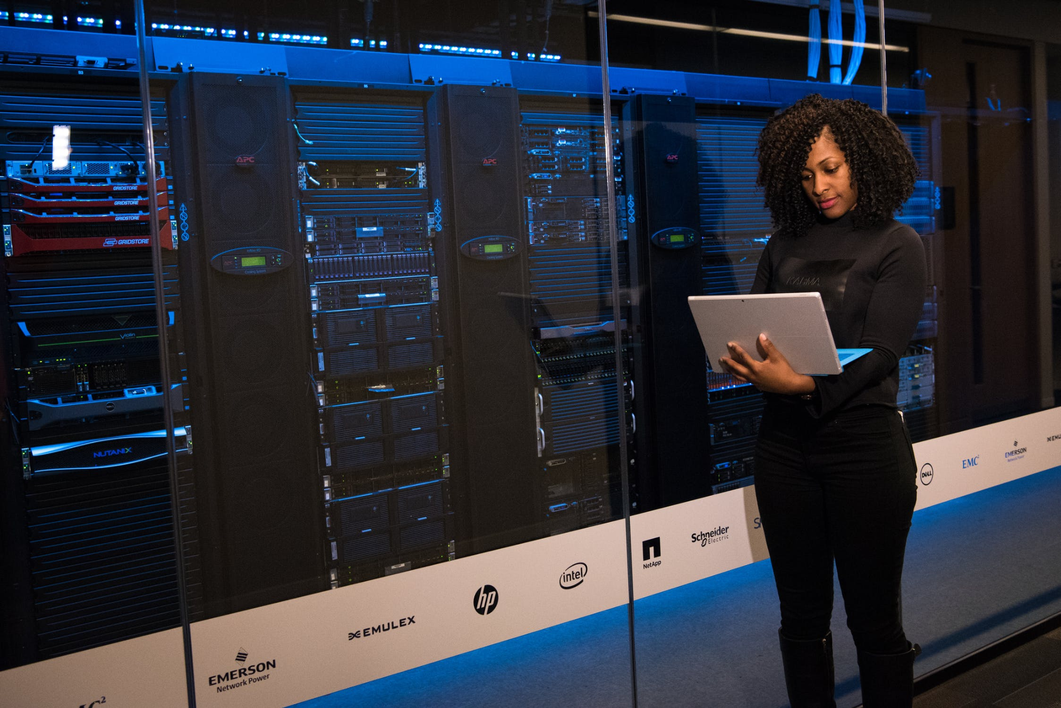
Larger web services
Activity 1
Large online services like Google, Facebook, and Twitter host their own web services.
They have dedicated data centres to hold all of the web technologies that they need to run the services that they offer.
Notes:
Image source: https://www.pexels.com/photo/woman-standing-while-carrying-laptop-1181354/

Slide 18
Larger web services
Activity 1
Google currently has 23 data centres all around the world.
These will include backups at separate locations to protect them from events like fire or flooding.
Data centres (ncce.io/datacentres)
Notes:
Image source: https://www.pexels.com/photo/woman-standing-while-carrying-laptop-1181354/

Slide 19
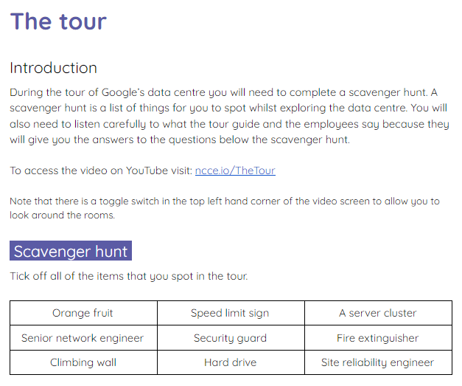
Take a tour!
Activity 1
You are now going to take a tour of one of Google’s data centers.
Whilst watching the video, complete the activity sheet, which includes a scavenger hunt of things to spot during the tour.
The tour (ncce.io/TheTour)

Slide 20

The cloud
Activity 2
The cloud is a term used to describe software and storage that are used through the internet.
The cloud is not floating around in the sky. It exists in data centres like the ones at Google.
Notes:
Image source: https://pixabay.com/photos/sky-clouds-sunlight-atmosphere-414199/

Slide 21
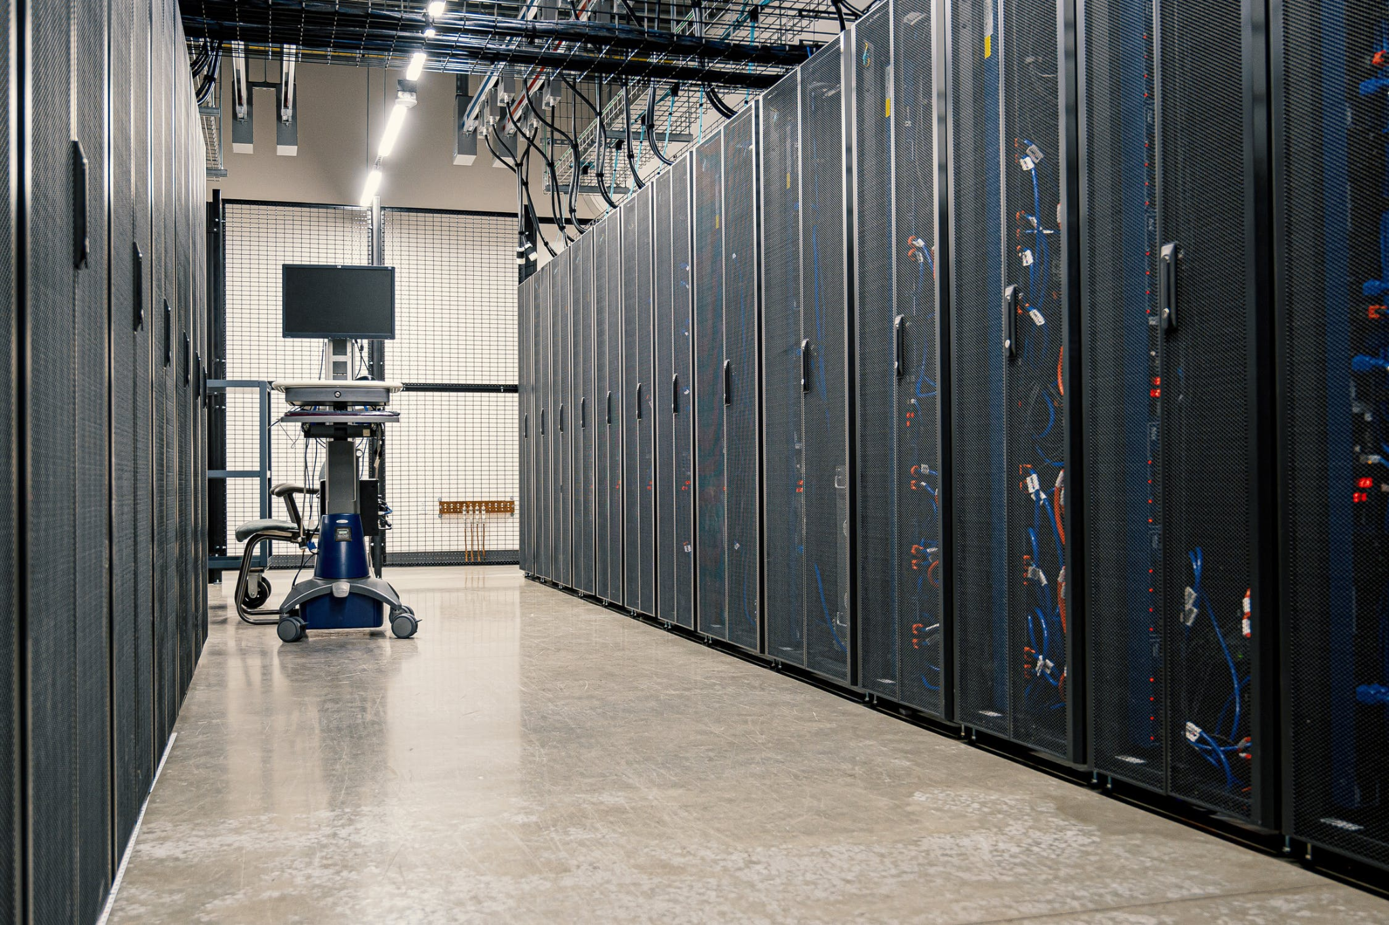
The cloud: Software as a service (SaaS)
Activity 2
The cloud gives us access to Software as a Service (SaaS). This means that we can use software on our devices that is hosted elsewhere on a server.
The benefits of this are:
Automatic software updates
Automatic saving
Automatic backups
Accessible from anywhere with an internet connection
Sharing capabilities
Notes:
Image source: https://www.pexels.com/photo/server-racks-in-modern-data-center-4508751/

Slide 22
The cloud: Saas
Activity 2
There are also some drawbacks:
Potentially paying a monthly subscription (if service isn’t free)
Must be connected to the internet to access the software
Less control over your data (it could be stored in other countries that have different laws surrounding data protection)
Notes:
Image source: https://www.pexels.com/photo/server-racks-in-modern-data-center-4508751/

Slide 23
The cloud: Storage
Activity 2
The cloud can also be used for storage. Instead of backing up your files locally on your own device, you can back them up on cloud storage.
The benefits of this are:
Cloud storage has its own built in backup system to protect your files
Data can be backed up automatically
You can often get a small amount of storage for free
It can save money on maintenance
Notes:
Image source: https://www.pexels.com/photo/server-racks-in-modern-data-center-4508751/

Slide 24
The cloud: Storage
Activity 2
The drawbacks of this are:
As your storage increases, you may need to pay a larger fee
You have less control over your data (for the same reasons as SaaS)
It relies on an internet connection to access your data
Switching cloud storage suppliers can be problematic
Notes:
Image source: https://www.pexels.com/photo/server-racks-in-modern-data-center-4508751/

Slide 25
Which cloud services have you heard of/used?
Activity 2
Think, write, pair, share
There are many cloud services available for you to use. We use some of them at school.
List as many services as you can think of!
Notes:
Image source: https://www.pexels.com/photo/server-racks-in-modern-data-center-4508751/

Slide 26
Which cloud services have you heard of/used?
Activity 2
Google docs, slides
Xbox cloud
iCloud – iPhone, iPad backup
Dropbox
Samsung cloud
Microsoft 365
The online version of Scratch
Canva
Google photos

Slide 27
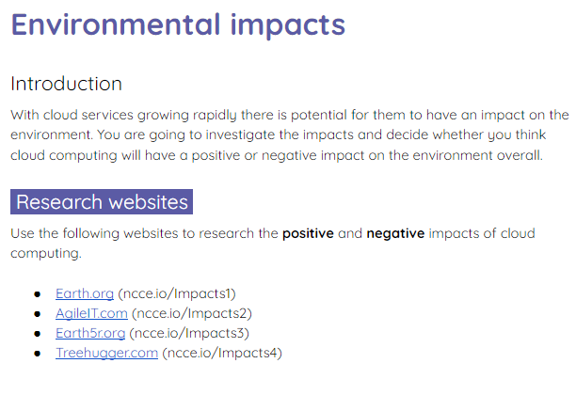
Environmental impacts
Activity 3
Use the activity 3 sheet to research the environmental impacts of cloud computing.

Slide 28

Voting time
Wrap Up
Share your top positive and negative impacts with the class.
Take a vote on whether the class feels that cloud computing has a positive or negative impact on the environment.
Notes:
Image source: https://pixabay.com/photos/pros-and-cons-compare-choice-5201376/

Slide 29
Next lesson
Summary
In this lesson, you…
Learnt about cloud services and where these are hosted online
Next lesson, you will…
Learn about network protocols

